Slide 1

Analysis of Space-based Riometer Measurement data for characterization of Radio Propagation Disturbance in the Ionosphere
George Klett and Victor Mandala
Mentor: Dr. Ahmed I. Sulyman

Slide 2
Agenda
Background
Research Scope
Data sets
Figures

Slide 3
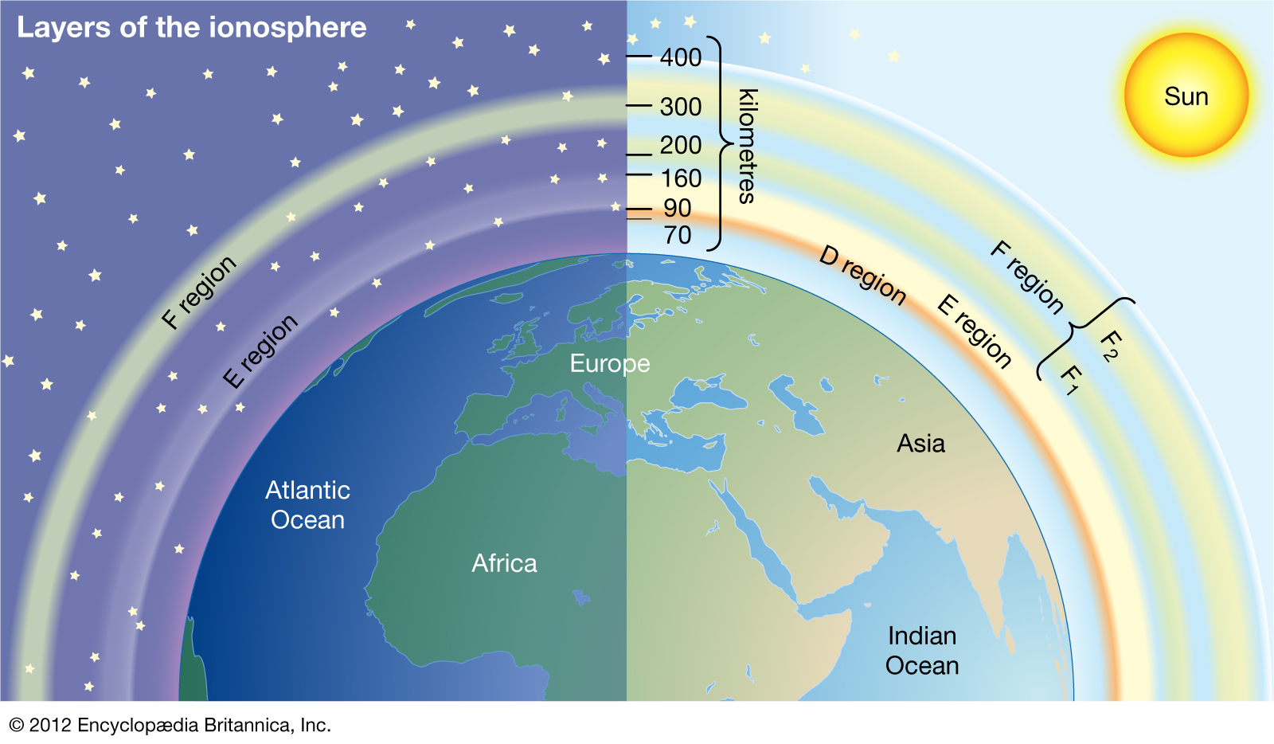
Background
What is an ionosphere?
Why do I care?

Slide 4
HF Propagation - VHF Absorption
Some "Sporadic" E -> lower frequencies pass through rather than reflect
F is main driver
D layer absorbs HF -> active during day only. Lyman-α (121.6 nm)

Slide 5
Riometer
Relative Ionospheric Opacity
Absorption
D layer

Slide 6
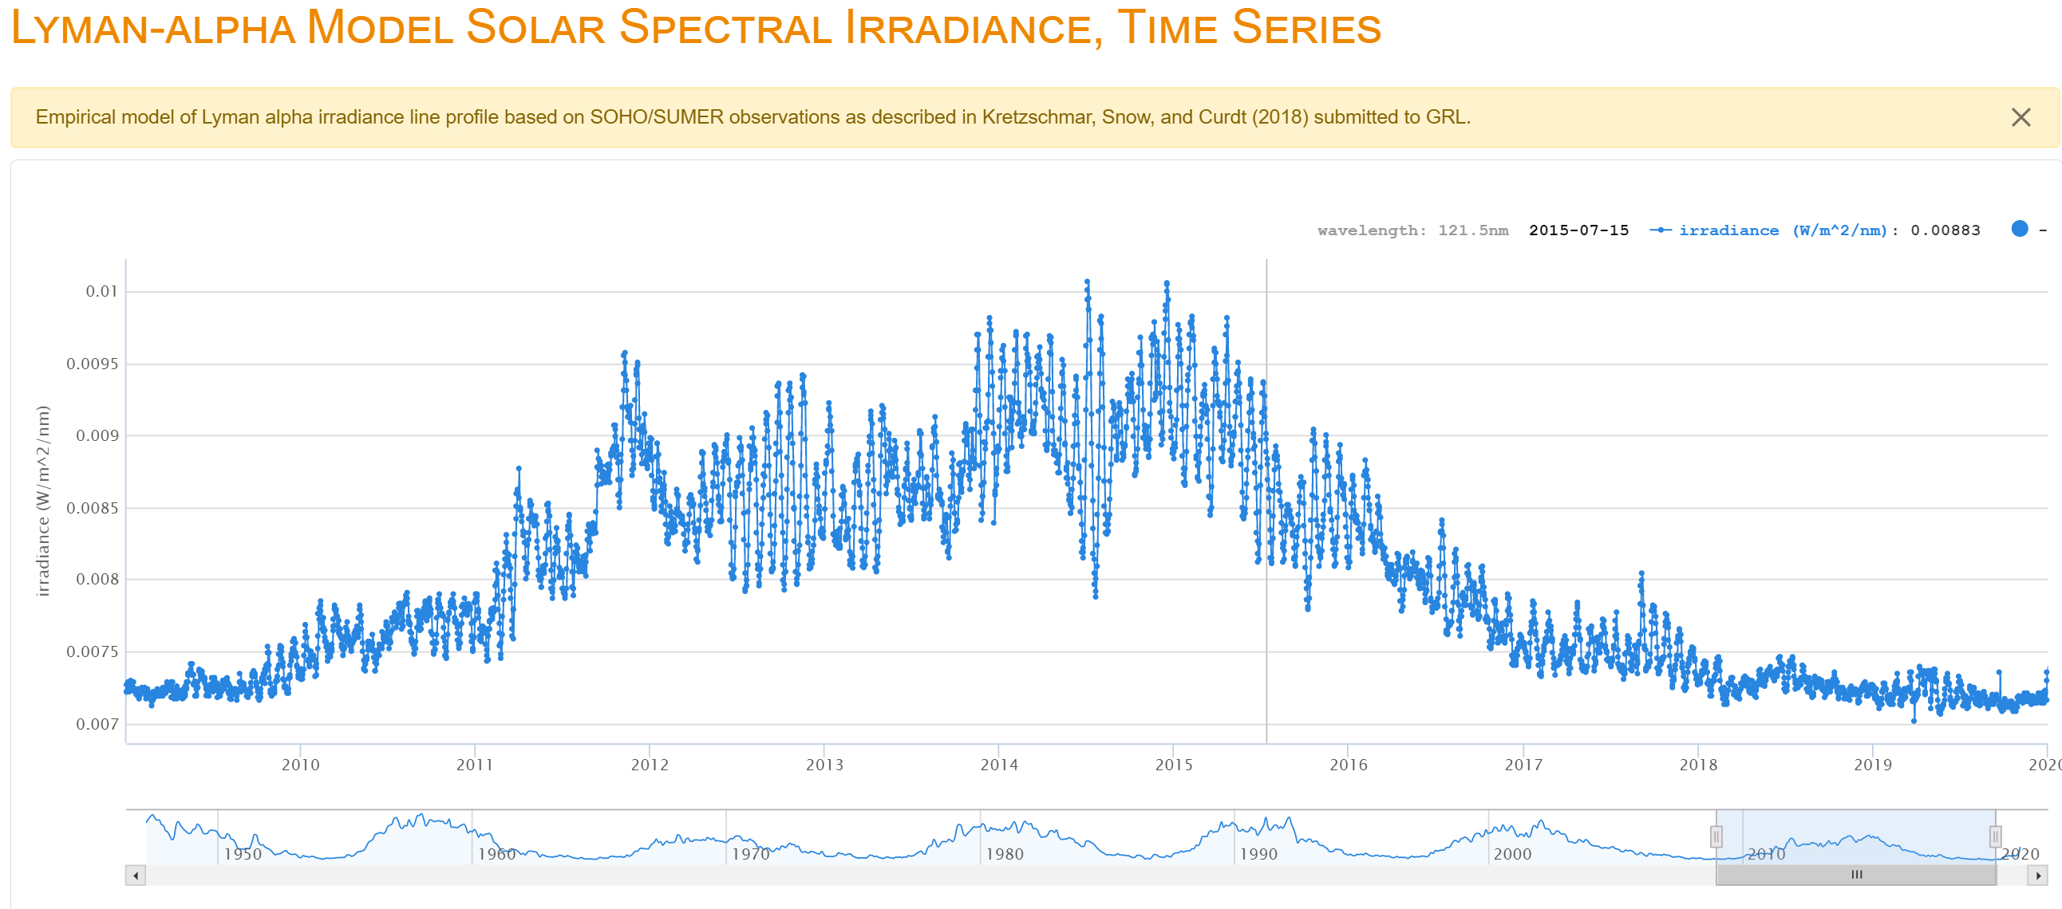
Research Scope
Examine the effects of solar activity on the ionosphere.
Correlate to previous research of effects of absorption on 38GHz.
Solar activity -> Lyman-α series (121.6 nm)
D-layer -> riometer
Absorption -> terrestrial based measurements.
Notes:
Follow how life works
Sun has the radiation
Makes the ionosphere opaque
Make the radio waves absorbed.

Slide 7
Data sets
Total Solar Irradiance (TSI) - (W/m^2) - Level 3
  Total radiation from the sun measured at 1 AU
EUV SpectroPhotometer - (ESP) - Level 0CS
  Irradiance around 30.4 nm
  Irradiance around 121.6 nm (Lyman-α)
Solar Flux Density – SFU = 10^-22 * W/(m^2 * Hz)
  Time density of energy from the sun on earth's surface
Absorption – (dB loss)
  Energy loss of radio waves, 3 dB loss ~ ½ of power lost
Notes:
Follow structure as before
Radiation from sun
Observed opacity
Measured absorption

Slide 8
Progress To Date
Good News
Bad News
Lots of code done
  Importing
  Processing
  Plotting
Not enough Data
  Waiting for more riometer data
  Incomplete data sets
Our findings rely on a long timeframe
  Many things affect the ionosphere
  Randomness in short term
  Monte-Carlo
Notes:
What does this mean?
We have about 2 months of data, when we want to have 11 years. This sounds bad, and it honestly is.
BUT there is good news. Most of the time of a project, the hard work, is coding and creating tools to process data.
The tools and code George created are modular, they can work on new data

Slide 9
Data Gathering
Some data we have easy access to
  level 3 data, a single file
  Riometer
  TSI
Some data takes more time
  Python coded API tools
  EUV Irradiance
  GOES, EVE, LISIRD, etc. Level 0-2 can be hundreds or thousands of files

Slide 10
Data Processing Methods
Developed Tools
  Import data from .txt files
  Process it
    Highest value -> filter to one value per day for compatibility with Level 3 data
  Plot it
Have modularized code for when more data is received, will be a shorter amount of time to process it.

Slide 11
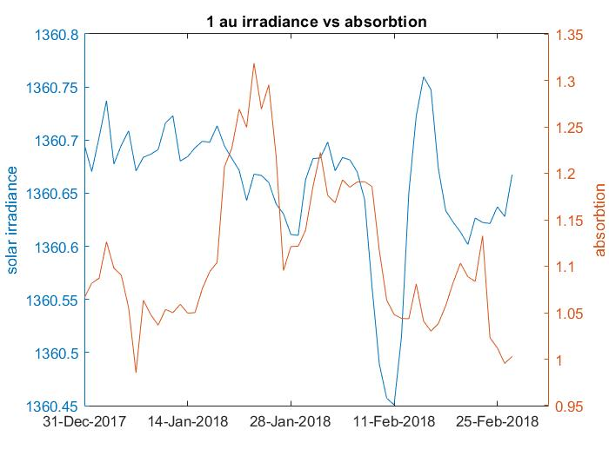

Slide 12
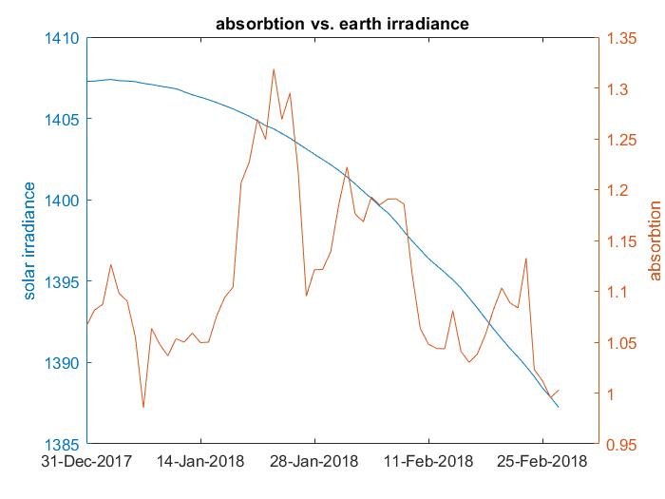

Slide 13
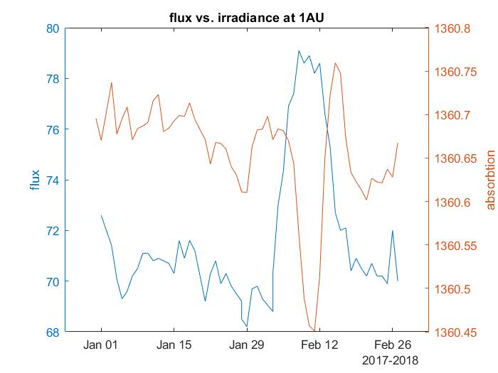

Slide 14


